Slide 1
Neural rendering

Slide 2
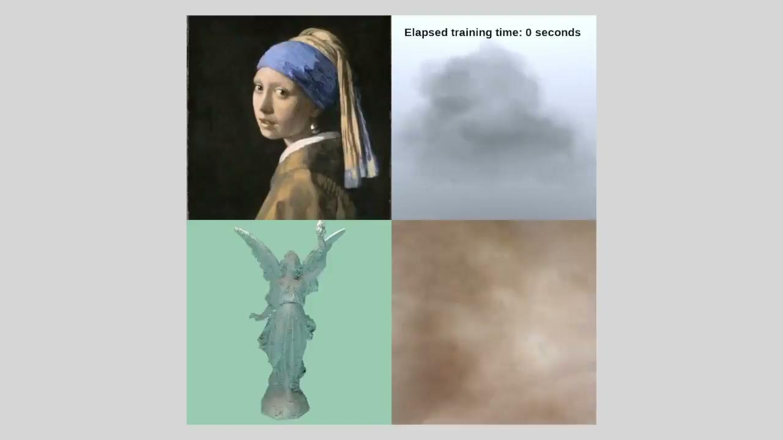
Notes:
https://doi.org/10.1145/3528223.3530127

Slide 3
Structure of this talk
Multi-view stereo
The problem: novel view synthesis
Review: the light field representation
Neural radiance fields
Volumetric grids
Future work

Slide 4
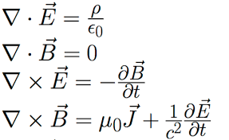
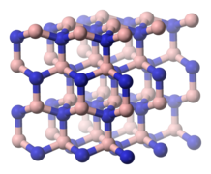
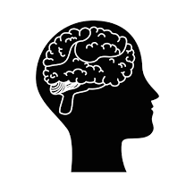
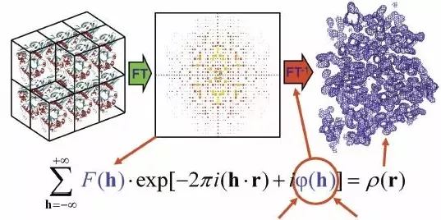
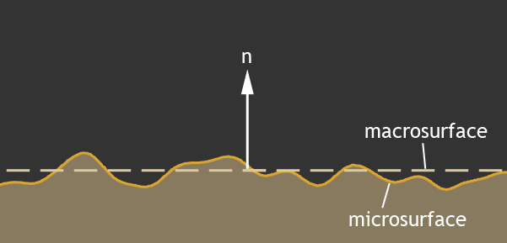
A related problem: 3D reconstruction
The Problem: Optimize a 3-dimensional representation of a scene subject to multiple constraints
This is impossible
????
????
Just give up??

Slide 5
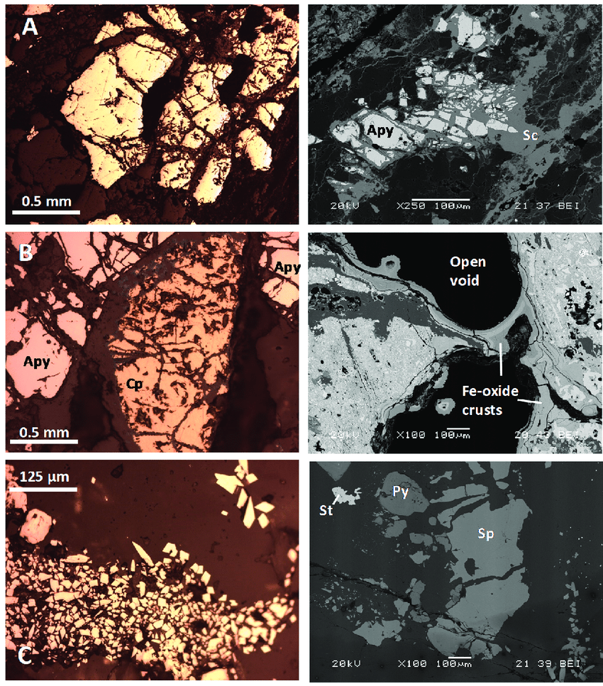
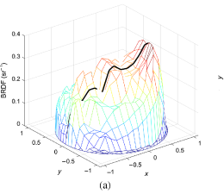
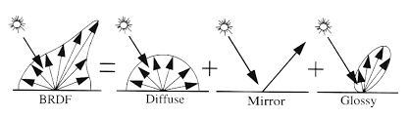
Idea: physically based inversion
Create a physically accurate model of the scene’s optical response
Not enough information to infer this from RGB images, as the spectral response of the scene is not fully captured
Even solving the forward problem is computationally intractable
Idealized BRDFs used in computer graphics
Real BRDF
Notes:
https://resources.mpi-inf.mpg.de/departments/d4/teaching/ws200708/cg/slides/CG07-Brdf+Texture.pdf
https://doi.org/10.1117/1.oe.58.12.124106
https://www.researchgate.net/publication/346985444_Arsenic_in_Soils_Affected_by_Mining_Microscopic_Studies_vs_Sequential_Chemical_Extraction

Slide 6
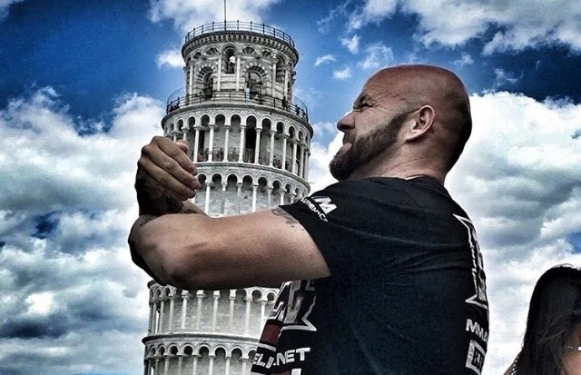
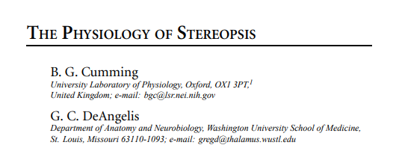

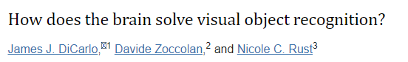
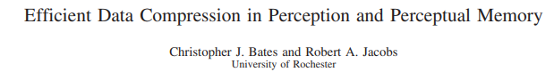
Aside: how do humans do this?
Combination of multiple depth cues (parallax, vergeance, accommodation, defocus, chromatic aberration)
We just remember how things look (?)
Notes:
https://pubmed.ncbi.nlm.nih.gov/11283310/
https://pubmed.ncbi.nlm.nih.gov/30409861/
https://www.ncbi.nlm.nih.gov/pmc/articles/PMC3306444/
https://www2.bcs.rochester.edu/sites/robbie/BatesJacobs_PsychRev2020.pdf

Slide 7
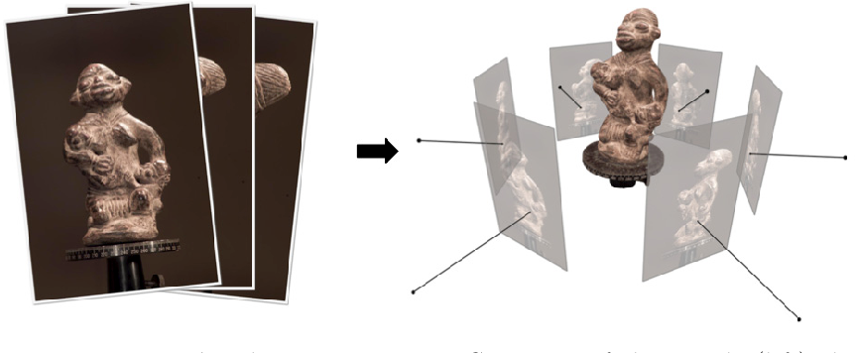
Multi-view stereo
Identify similar looking image patches between pairs of pictures
Triangulate locations of corresponding points
Construct a mesh from triangulated points
Notes:
https://carlos-hernandez.org/papers/fnt_mvs_2015.pdf

Slide 8
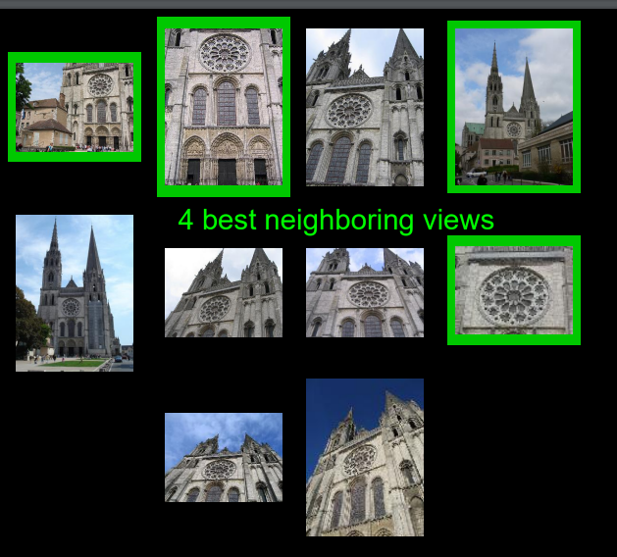
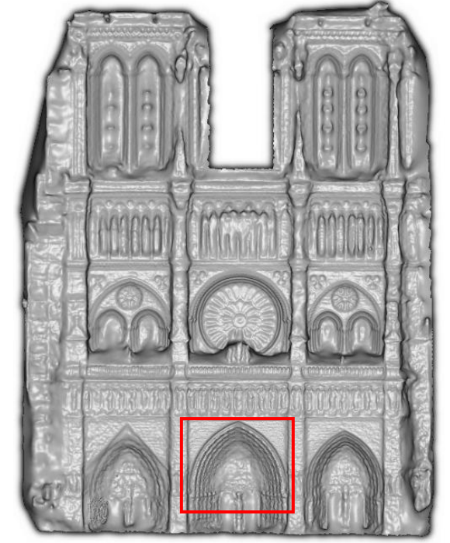
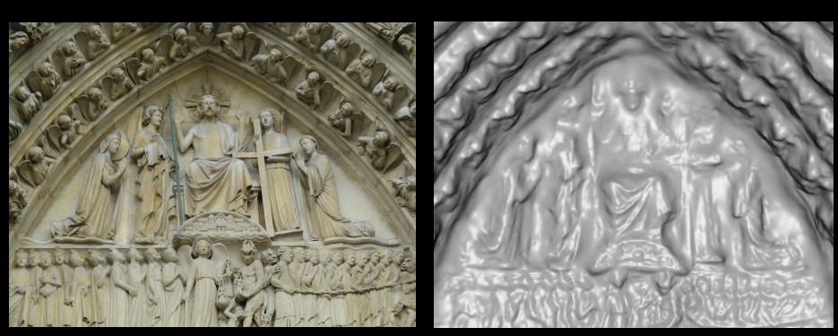
Multi-view stereo
Assumes perfectly diffuse objects i.e., the objects being reconstructed look the same from any viewing angle.
Struggles to triangulate points within textureless color fields
Occlusion and disocclusion are challenging
Notes:
https://courses.cs.washington.edu/courses/cse455/10wi/lectures/multiview.pdf

Slide 9
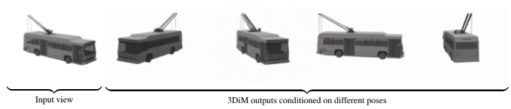
Novel view synthesis
Easier problem: given a stack of input views, interpolate images captured from new viewpoints
That this does not require a physically correct model of light propagation.
Objects and light sources don’t need to be spatially localized
Notes:
https://arxiv.org/abs/2210.04628

Slide 10
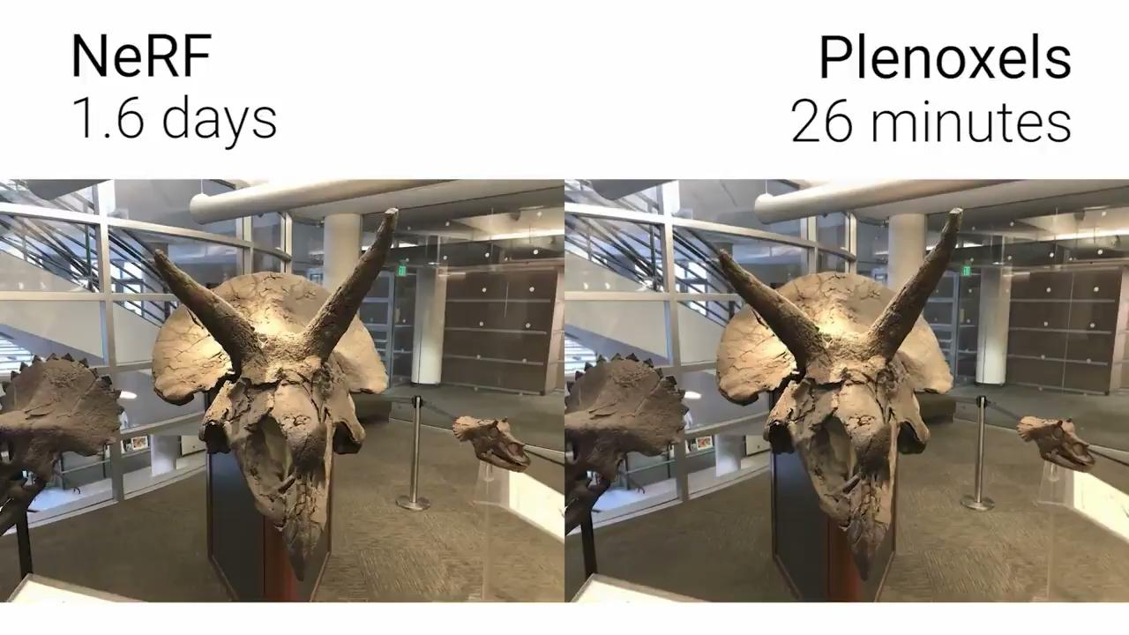
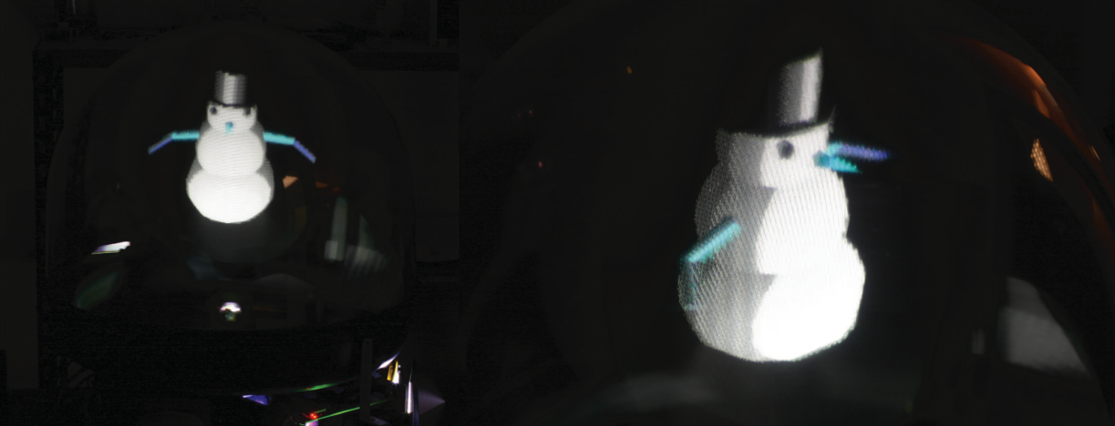
Idea: numerical light field solvers
Place a large number of spherical light sources with directionally varying color
A dense enough arrangement can approximate any light field
Does not require a physically accurate model of surfaces’ spectral response
Notes:
https://compphotolab.northwestern.edu/wordpress/wp-content/uploads/2015/04/Occlusion_Capable.pdf
https://alexyu.net/plenoxels/

Slide 11
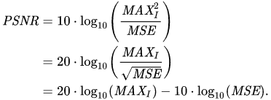
Measuring performance
Measuring image quality is a difficult problem. No existing performance measure captures perceptual image quality
Peak signal-to-noise ratio (PSNR) is one commonly used option because it is easy to calculate
Notes:
https://en.wikipedia.org/wiki/Peak_signal-to-noise_ratio

Slide 12
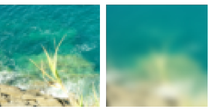
Measuring performance
Structural similarity index measure (SSIM) is an alternative that attempts to align better with human perception
Learned perceptual image patch similarity (LPIPS) is a recently invented metric.
LPIPS uses features from a pre-trained neural network to measure image similarity
These image patches are rated as similar by SSIM, but dissimilar by deep features
Notes:
https://arxiv.org/pdf/1801.03924.pdf

Slide 13
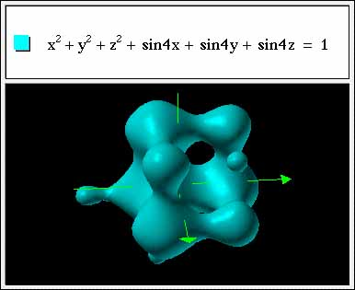
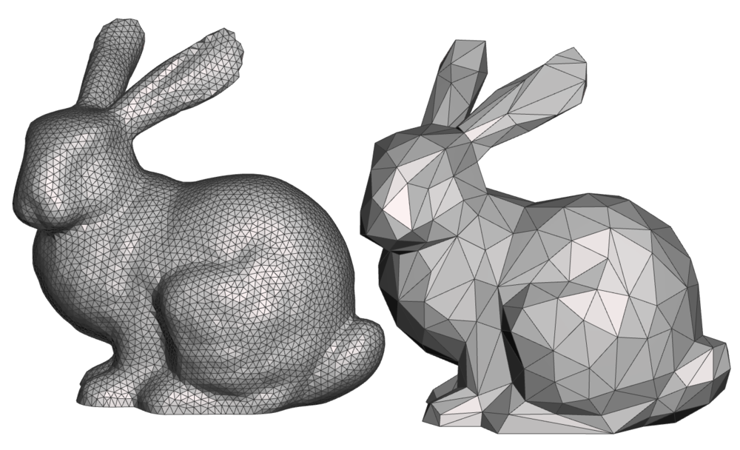
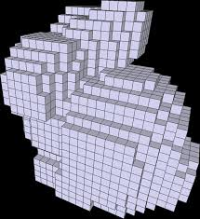
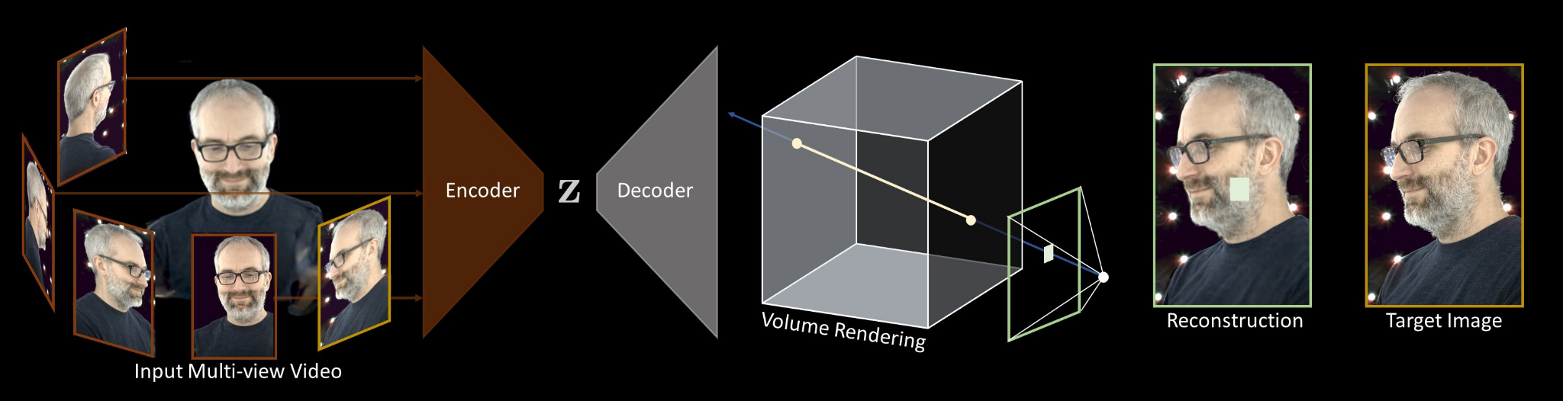
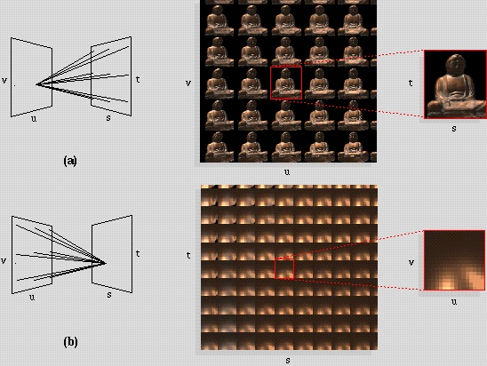
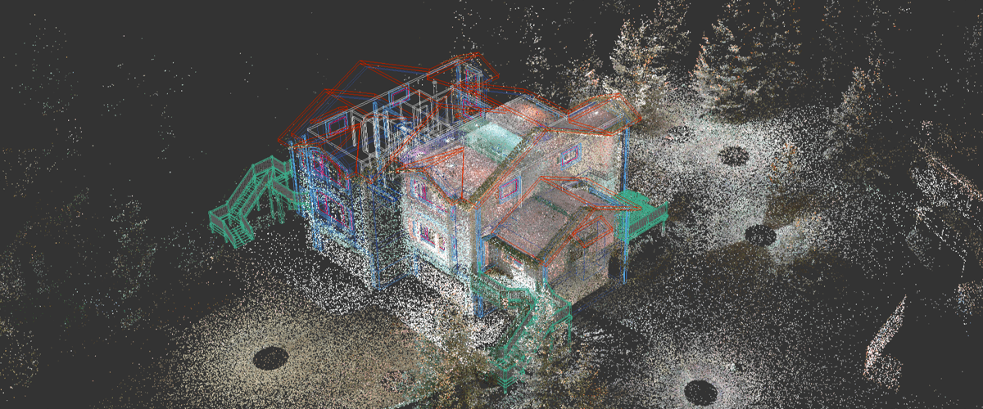
Scene representations
Surface
Mesh
Signed distance function
Volume
Voxel grid
Neural volumetric
Point cloud
Light field

Slide 14
Space-time tradeoff
Light field
Explicit volume grid
Polygonal mesh
Memory
Implicit surface and Implicit volume
Compute

Slide 15
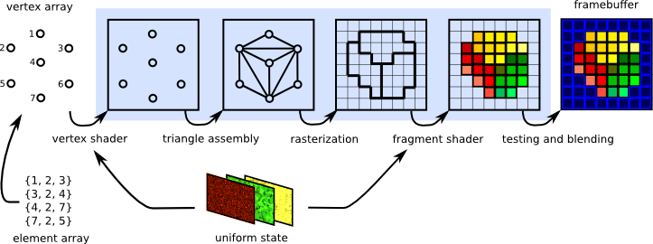
The graphics pipeline
Triangles are the graphics primitive of choice for most modern applications (why?)
Step 1: Place vertices
Step 2: Topology (connect vertices)
Step 3: Rasterization (transform triangles in 3d space to pixels)
Step 4: Shade pixels
Notes:
https://graphicscompendium.com/intro/01-graphics-pipeline

Slide 16
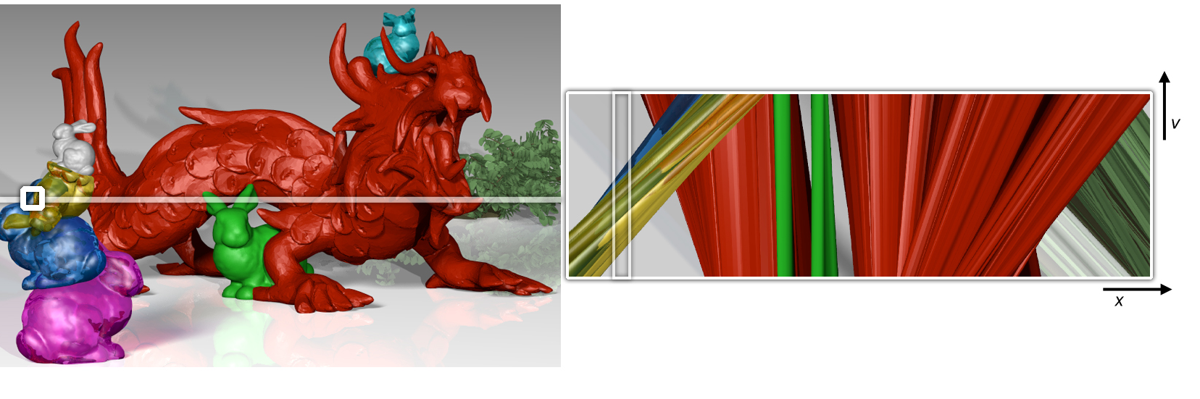
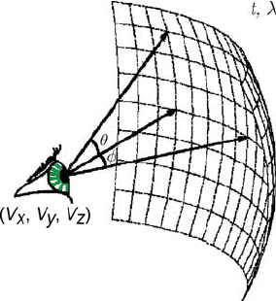
What is a neural scene representation?
There are many possible choices of scene representation.
One approach is to use an explicit data structure (e.g. triangular mesh)
Alternatively, we can represent the scene using an implicit function. This saves memory, but costs performance.
The goal of a neural scene representation is to use a neural network to learn this function
Notes:
https://web.media.mit.edu/~gordonw/CompressiveLightFieldPhotography/
https://www.researchgate.net/figure/A-schematic-view-of-the-plenoptic-function_fig1_220067050

Slide 17
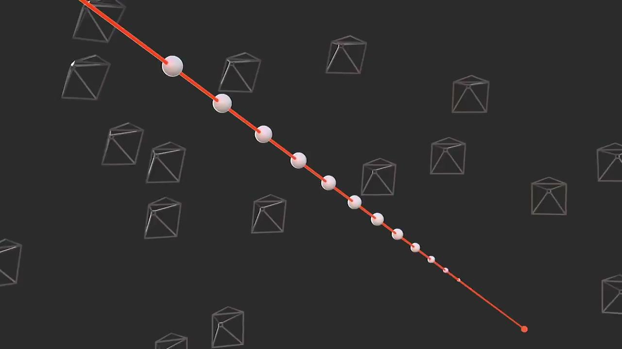
Neural radiance fields (NeRF)
NeRF is a numerical light field optimization method. NeRF is geometrically aware. This allows for very robust multi view consistency.
Not learning the light field directly! We are learning a radiance field
The light field is the integral of the radiance field
Neural networks can distribute compute well. Optically simple parts of the scene converge quickly.
Notes:
https://arxiv.org/abs/2003.08934

Slide 18

Notes:
https://doi.org/10.1145/3528223.3530127

Slide 19
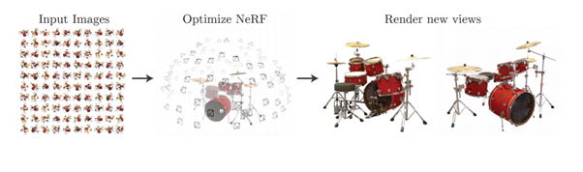
Implementation details
Input: stack of images of a scene taken from many different angles
Represent the scene as a radiance field: the scene is filled with spherical emitters that don’t occlude each other
Render images of the radiance field from the same viewpoints as the input images
Optimize the brightness and color of the radiance field by backpropagation
Notes:
https://arxiv.org/abs/2003.08934

Slide 20
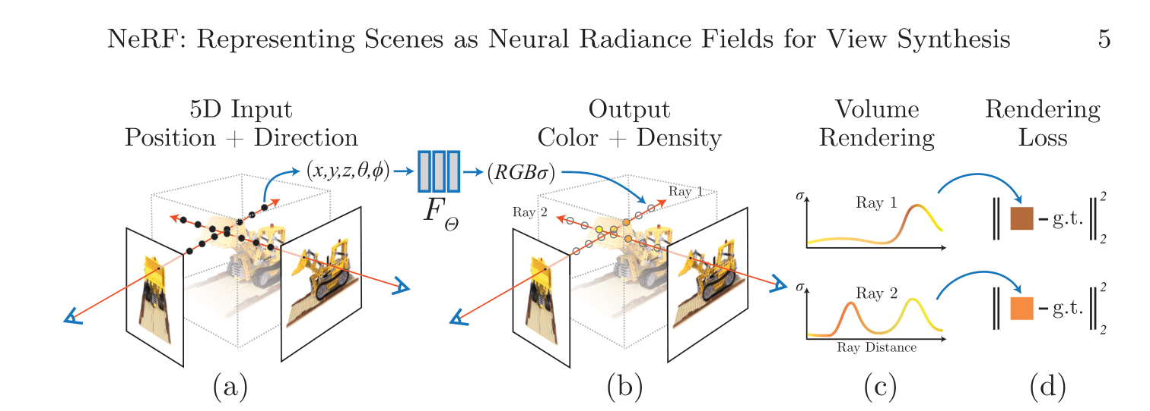
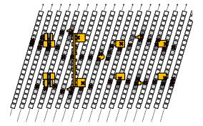
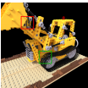
Implementation details
On each iteration, compute the color of each pixel by adding radiance values along a ray
We really want to compute the integral along the ray, but we have to discretize
Importance sampling is one solution (see Mildenhall et al 2020)
Notes:
https://arxiv.org/abs/2003.08934
https://arxiv.org/abs/2103.03231

Slide 21
Positional encoding
In general, neural networks are biased towards learning low frequency functions, so the output of NeRF will be blurry
Instead of directly using (x,y,z) coordinates, decompose spatial coordinates into sinusoids
This allows the network to learn high frequency features
L is a tunable hyperparameter which can control the maximum level of detail the network is able to learn
Notes:
https://arxiv.org/abs/2003.08934

Slide 22
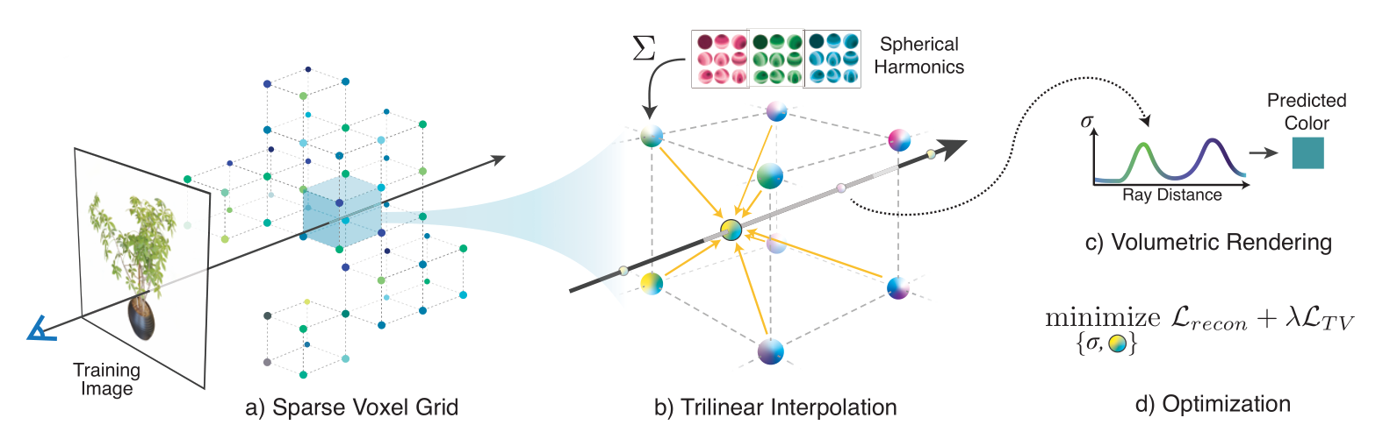
Volume grids
Place directionally varying spherical emitters aligned to a 3d uniform grid
Great render speed and optimization performance
Large memory footprint
Scales poorly to unbounded scenes
Notes:
https://alexyu.net/plenoxels/

Slide 23
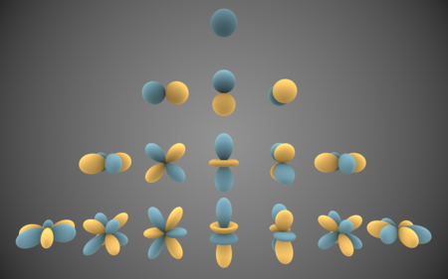
Aside: spherical harmonics
Similar to Fourier series
Spherical harmonics are a basis for functions defined on the surface of a sphere
Any function defined on the surface of a sphere can be represented by a linear combination of spherical harmonics
Commonly used in graphics to capture directionally varying appearance
Notes:
https://en.wikipedia.org/wiki/Spherical_harmonics

Slide 24
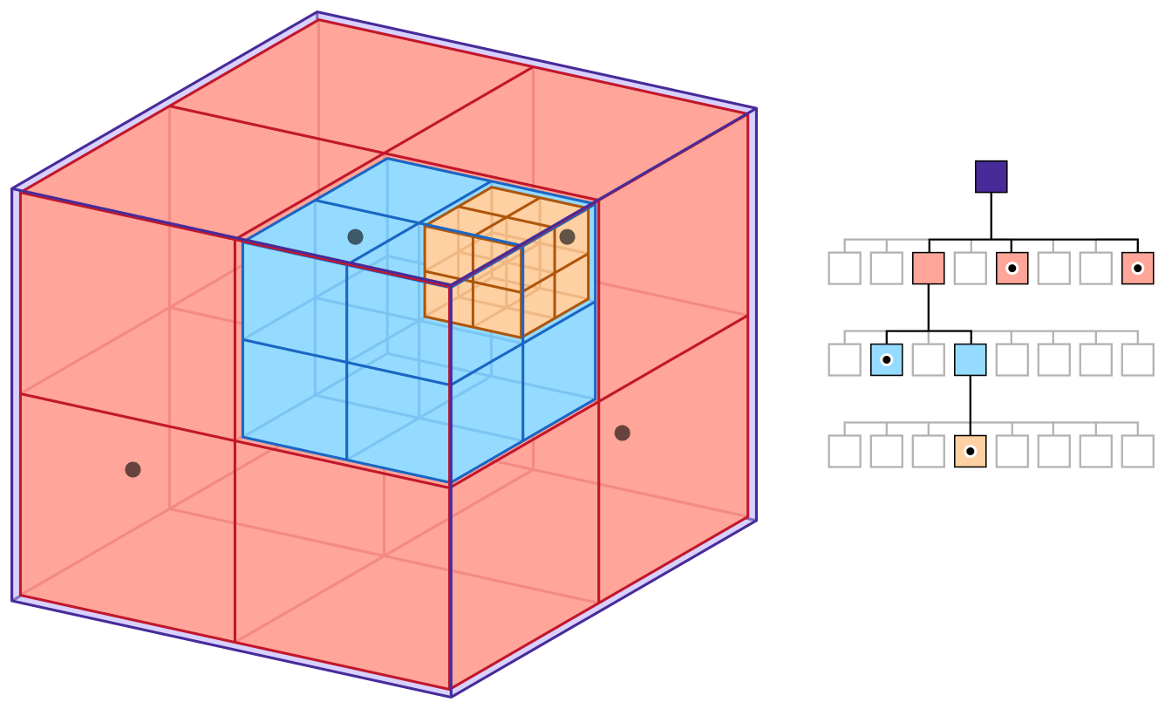
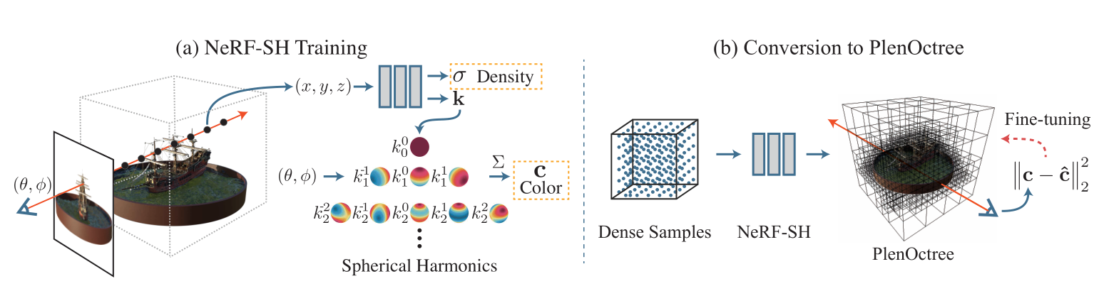
Octrees
Instead of a uniform grid, recursively subdivide space using a tree data structure
Better memory utilization than uniform grids, but harder to construct and optimize
Notes:
https://developer.apple.com/documentation/gameplaykit/gkoctree
https://alexyu.net/plenoctrees/

Slide 25
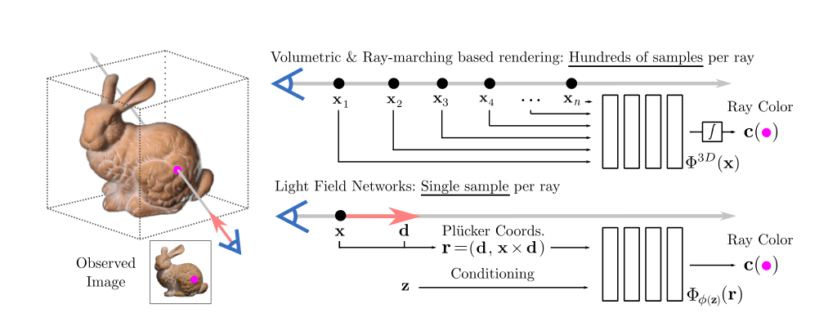
Light field networks
Just have the network directly predict the light field
Orders of magnitude faster render speed
Notes:
https://arxiv.org/abs/2106.02634

Slide 26
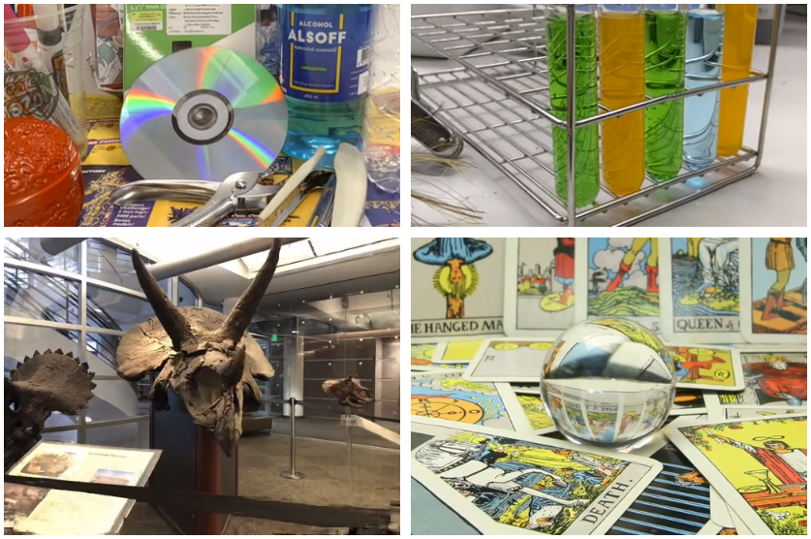
The curse of dimensionality
Each pixel in each viewpoint is a degree of freedom
The network must have a very high number of parameters to accurately capture the light field
Geometric artifacts when interpolating between perspectives.
Need a stronger geometric prior to ensure multi-view consistency
A hybrid approach
Notes:
https://arxiv.org/abs/2112.01523

Slide 27
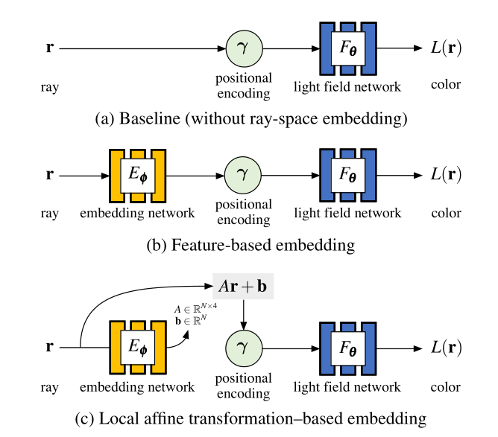
Light field networks
Learning a light field is possible, but light fields are more difficult than radiance fields
Key observation: we can use a neural network to perform compression on the space of rays (embedding network)
This approach still results in low angular resolution
Notes:
https://arxiv.org/abs/2112.01523

Slide 28
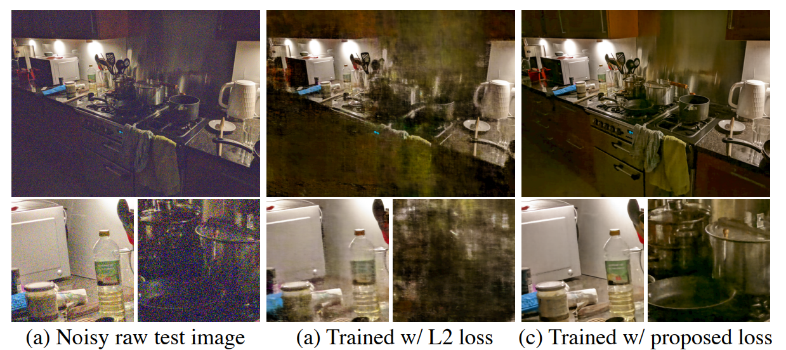
Applications
VR content creation
Computational imaging
Notes:
https://zollhoefer.com/papers/arXiv21_3DV/page.html
https://bmild.github.io/rawnerf/

Slide 29
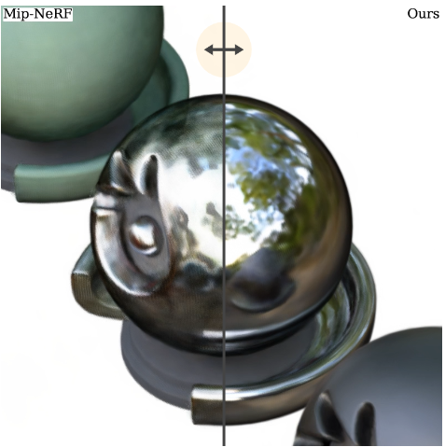
Limitations
Current implementations require posed cameras
Computationally intensive
Can’t do complicated optical effects (refraction, curved mirrors)
Notes:
https://dorverbin.github.io/refnerf/

Slide 30
Future work
NeRF requires dozens to hundreds of reference images. Improving performance on sparser data is key
Reconstruction artifacts. Scene representations which can accurately model mirrors and lenses are needed
Compositionality, scene editing, and animation
Interop with existing tools (Blender)

Slide 31

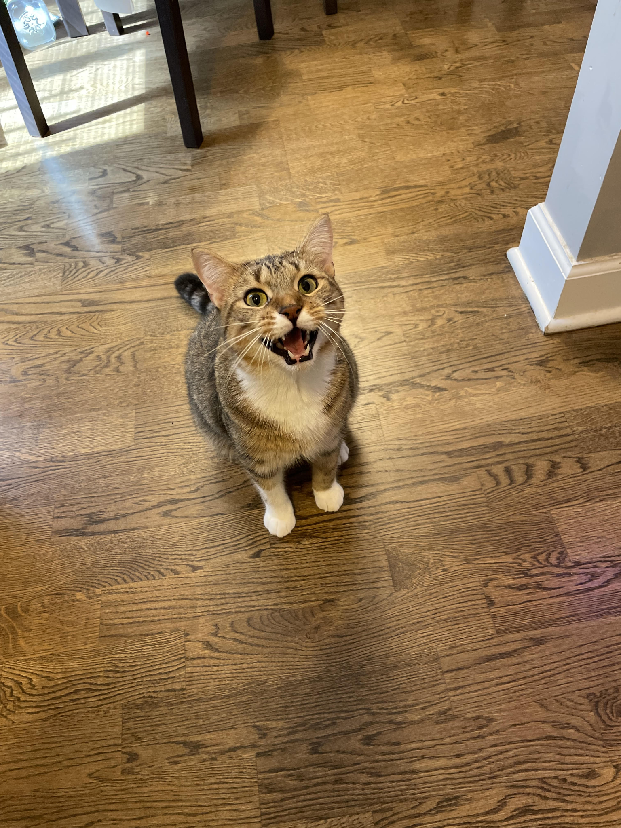
Thank you!

Slide 32
Works cited
Müller, T., Evans, A., Schied, C., & Keller, A. (2022). Instant neural graphics primitives with a multiresolution hash encoding. ACM Transactions on Graphics, 41(4), 1–15. https://doi.org/10.1145/3528223.3530127
Li, H., Chen, M., Deng, C., Liao, N., & Rao, Z. (2019). Versatile four-axis gonioreflectometer for bidirectional reflectance distribution function measurements on anisotropic material surfaces. Optical Engineering, 58(12), 1. https://doi.org/10.1117/1.oe.58.12.124106
Cumming, B. G., & DeAngelis, G. C. (2001). The physiology of stereopsis. Annual Review of Neuroscience, 24(1), 203–238. https://doi.org/10.1146/annurev.neuro.24.1.203
Bellmund, J. L., Gärdenfors, P., Moser, E. I., & Doeller, C. F. (2018). Navigating cognition: Spatial codes for human thinking. Science, 362(6415). https://doi.org/10.1126/science.aat6766
DiCarlo, J. J., Zoccolan, D., & Rust, N. C. (2012). How does the brain solve visual object recognition? Neuron, 73(3), 415–434. https://doi.org/10.1016/j.neuron.2012.01.010
Furukawa, Y., & Hernández, C. (2015). Multi-view stereo: A tutorial. https://doi.org/10.1561/9781601988379
Cossairt, O. S., Napoli, J., Hill, S. L., Dorval, R. K., & Favalora, G. E. (2007). Occlusion-capable multiview volumetric three-dimensional display. Applied Optics, 46(8), 1244. https://doi.org/10.1364/ao.46.001244
Fridovich-Keil, S., Yu, A., Tancik, M., Chen, Q., Recht, B., & Kanazawa, A. (2022). Plenoxels: Radiance fields without neural networks. 2022 IEEE/CVF Conference on Computer Vision and Pattern Recognition (CVPR). https://doi.org/10.1109/cvpr52688.2022.00542
Vincent Sitzmann*, Semon Rezchikov*, William T. Freeman,Joshua B. Tenenbaum, Fredo Durand: Light Field Networks: Neural Scene Representations with Single-Evaluation Rendering (2021) 2021 NeurIPS The Conference and Workshop on Neural Information Processing Systems https://doi.org/10.48550/arXiv.2106.02634
Attal, B., Huang, J.-B., Zollhofer, M., Kopf, J., & Kim, C. (2022). Learning neural light fields with ray-space embedding. 2022 IEEE/CVF Conference on Computer Vision and Pattern Recognition (CVPR). https://doi.org/10.1109/cvpr52688.2022.01920
Verbin, D., Hedman, P., Mildenhall, B., Zickler, T., Barron, J. T., & Srinivasan, P. P. (2022). Ref-NERF: Structured view-dependent appearance for neural radiance fields. 2022 IEEE/CVF Conference on Computer Vision and Pattern Recognition (CVPR). https://doi.org/10.1109/cvpr52688.2022.00541
Li, T., Slavcheva, M., Zollhoefer, M., Green, S., Lassner, C., Kim, C., Schmidt, T., Lovegrove, S., Goesele, M., Newcombe, R., & Lv, Z. (2022). Neural 3D video synthesis from Multi-view video. 2022 IEEE/CVF Conference on Computer Vision and Pattern Recognition (CVPR). https://doi.org/10.1109/cvpr52688.2022.00544
Ben Mildenhall, Peter Hedman, Ricardo Martin-Brualla, Pratul Srinivasan, Jonathan T. Barron (2021). NeRF in the Dark: High Dynamic Range View Synthesis from Noisy Raw Images. https://doi.org/10.48550/arXiv.2111.13679
https://arxiv.org/abs/2103.03231
https://arxiv.org/abs/2003.08934
https://arxiv.org/abs/2103.03231

Slide 33
Media
https://en.wikipedia.org/wiki/Boron_nitride#/media/File:Boron-nitride-(wurtzite)-3D-balls.png
https://resources.mpi-inf.mpg.de/departments/d4/teaching/ws200708/cg/slides/CG07-Brdf+Texture.pdf
https://developer.apple.com/documentation/gameplaykit/gkoctree
http://www.gradientspace.com/tutorials/2017/8/30/mesh-simplification
http://www.pacifict.com/Examples/Example12.html
https://arxiv.org/pdf/2108.06925.pdf
https://research.fb.com/publications/neural-volumes-learning-dynamic-renderable-volumes-from-images/
https://www.bricsys.com/blog/point-clouds-6-scan-to-bim
https://graphicscompendium.com/intro/01-graphics-pipeline
https://www.researchgate.net/figure/A-schematic-view-of-the-plenoptic-function_fig1_220067050
https://web.media.mit.edu/~gordonw/CompressiveLightFieldPhotography/
https://en.wikipedia.org/wiki/Spherical_harmonics
https://www.quora.com/Structural-Biology-What-is-the-phase-problem
https://www.frommers.com/slideshows/848133-20-ridiculous-shots-of-tourists-holding-up-pisa-s-leaning-tower
https://www.researchgate.net/publication/346985444_Arsenic_in_Soils_Affected_by_Mining_Microscopic_Studies_vs_Sequential_Chemical_Extraction
https://arxiv.org/pdf/1801.03924.pdf
https://arxiv.org/abs/2210.04628

